Slide 1

DATA LENS
Deep learning to analyse the texts…..!

Slide 2
PROJECT OVERVIEW
OBJECTIVE:
To build an intelligent, user-friendly system that can understand any document, identify what it is about, analyze its sentiment, summarize it clearly, and present meaningful insights through simple visualizations.In simple words transforming the raw documents into meaningful,easy to understand insights using AI and NLP.
OUTCOMES:
Documents are categorized without any manual effort.
To improve the reliability and transparency we compared two models for topic detection and captures the true meaning of the content and gives the accurate results.
It detects the sentiment of the content and the results are shown using the intuitive guage visualizations.
It gives clear and human readable summaries to help the users to save time and it leads to faster decision making and better comprehension.

Slide 3
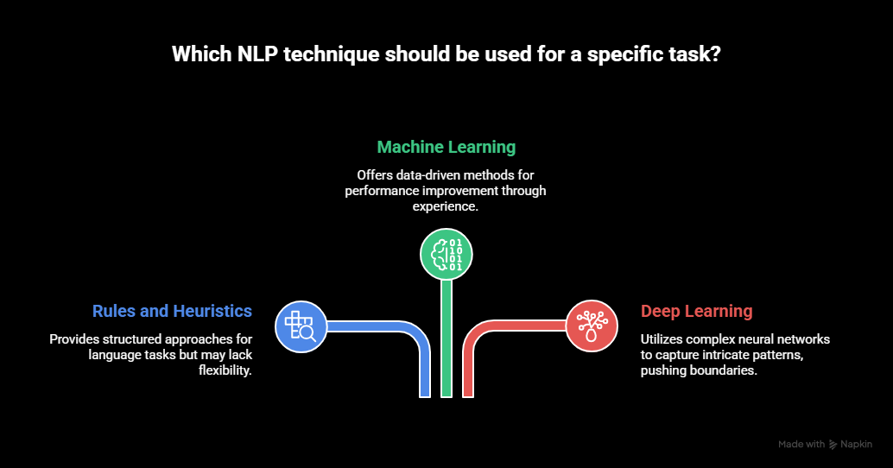
UNIQUENESS
Users can compare human-like understanding vs mathematical modeling.
Instead of trusting a single model:
Rule-based sentiment analysis
Neural network-based sentiment analysis
Results are visualized using real-time sentiment gauges.
Insights at a glance, even for non-technical users.
system shows how and why the result was produced.
Supports Real-World Documents.
User-Friendly for Non-Technical Users
Target Audience:
Students
News analysts
Content and media analysts

Slide 4
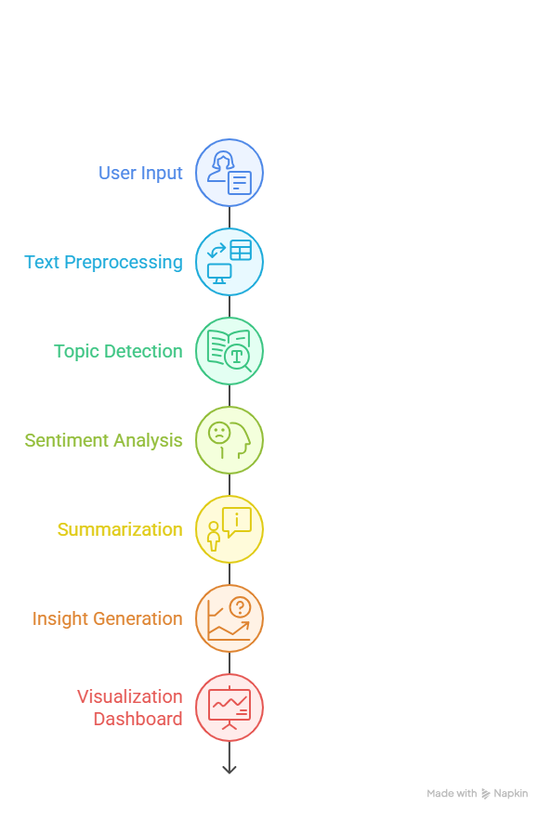
METHODOLOGY
User Input
The system accepts unstructured and structured data such as Text, PDF, CSV, and JSON files from users.
Text Preprocessing
Raw data is cleaned and prepared by removing noise, normalizing text, and extracting meaningful content for analysis.
Topic Detection
Advanced algorithms identify the core themes and dominant topics present in the text.
Sentiment Analysis
The emotional tone of the content is analyzed and classified as Positive, Negative, or Neutral.
Summarization
Large volumes of text are condensed into short, clear, and meaningful summaries.
Insight Generation
Key interpretations and patterns are extracted to answer “What does this data mean?”.
Visualization Dashboard
Results are presented using interactive graphs and visual insights for easy understanding and decision-making.

Slide 5
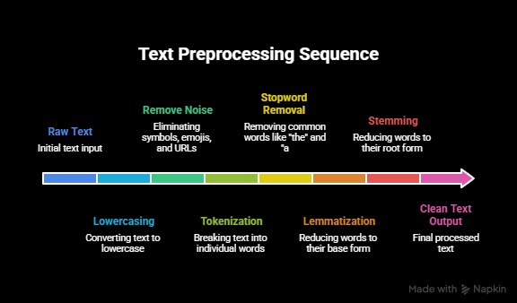
DATA PREPROCESSING
Preprocessing is nothing but cleaning and preparing the data.
Converting the raw unstructure text into clean normalise and machine processable form which is suitable for NLP algorithms.
It improves topic quality and reduce the memory usage.
TOOLS USED FOR PREPROCESSING:Custom pipeline,(NLTK),Regular expressions
I used wordNet for lemmatization here ,because it organises the words into synsets(sets of words with the same meaning) and it also used for Text Normalisation,Semantic Similarity,Wordsense Understanding.
NLTK gives us language intelligence:
how to split words
which words are useless
how to find base word forms

Slide 6
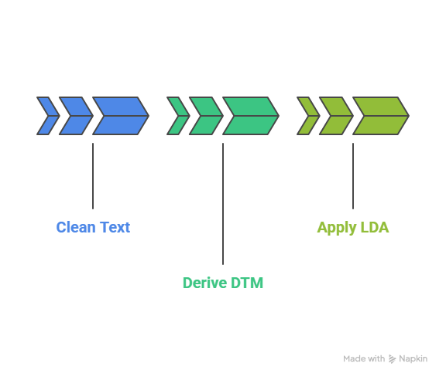
TOPIC DETECTION
Machine learning:
A Document–Term Matrix is a vector-space representation of a text corpus where each document is represented as a numerical vector of term weights.To convert the text in to numbers we use TF-IDF vectorizer which is present in Scikit-learn tool.
TF-IDF(TF*IDF):
How often a word appears inside on document and it penalizes words that appear in many documents
reduces weight of common words and increases weight of meaningful words.
DTM treats all words as equally important.
DTM Shape(3,4)[3 docs and 4 words]
Document | word1 | word2 | word3 | ...
doc1 | 0.3 | 0.0 | 0.5 | ...
doc2 | 0.0 | 0.6 | 0.1 | ...
doc3 | 0.4 | 0.2 | 0.0 | ...

Slide 7
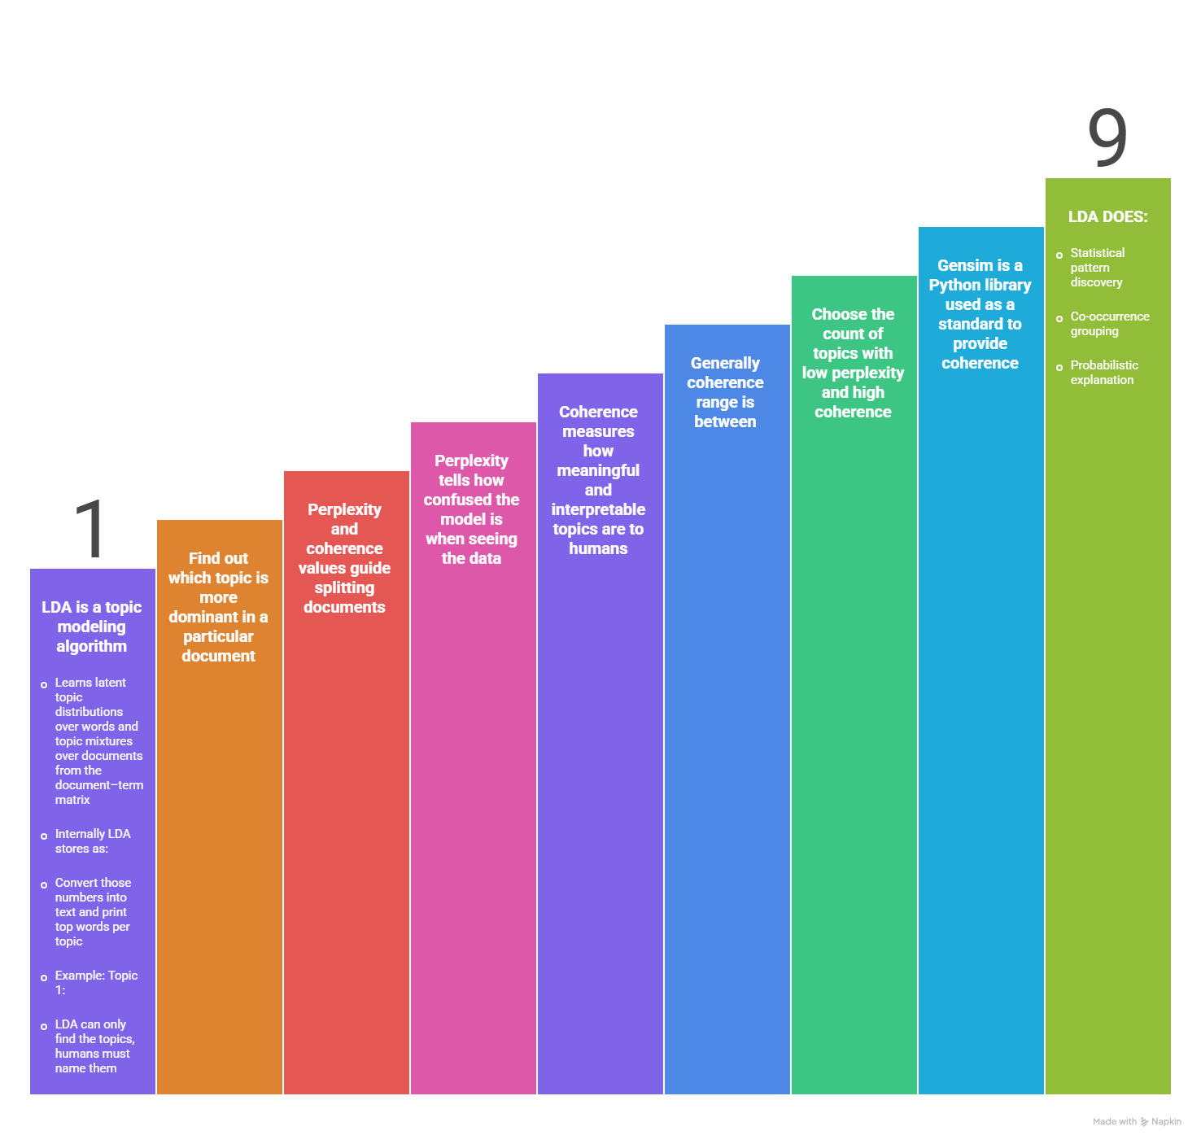
LDA:
LDA is a topic modeling algorithm which is a unsupervised ML type that automatically finds hidden topics in a large collection of documents.
The LDA model learns latent topic distributions over words and topic mixtures over documents from the document–term matrix
Internally LDA stores as:
Topic 1 → [0.12, 0.01, 0.30, 0.22, ...]
Topic 2 → [0.03, 0.28, 0.05, 0.01, ...]
Convert those numbers in to text and print top words per topic and after that we should see something like

Slide 8
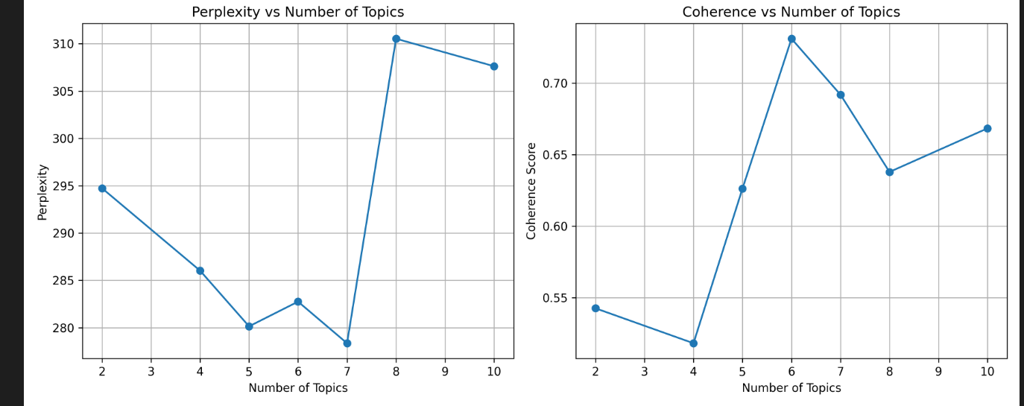
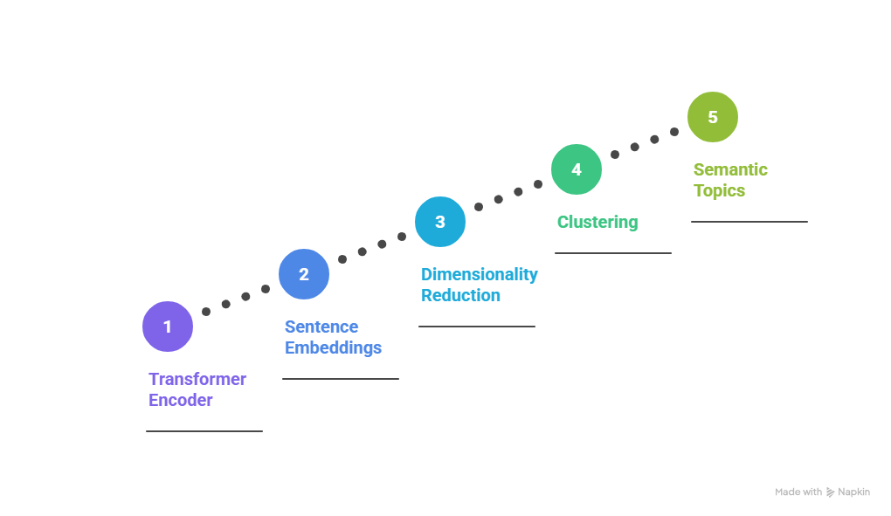
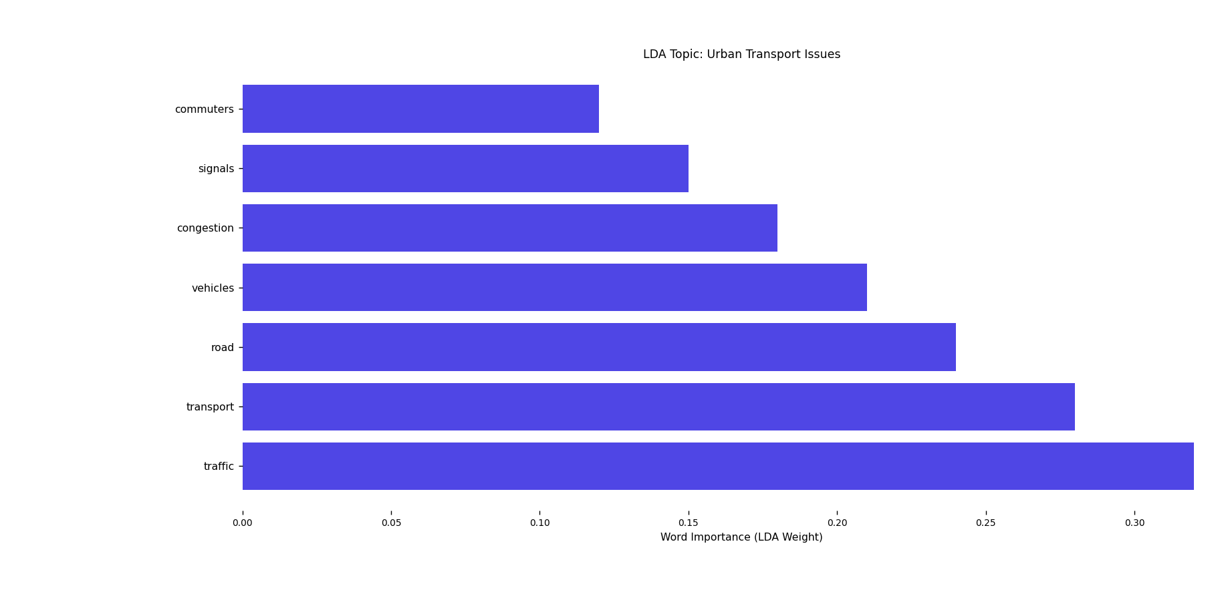
DEEP LEARNING:Deep learning semantic topic finding is a modern way to discover topics by understanding meaning (semantics) instead of counting words.
Deep learning models (Transformers) learn:
Context of words
Sentence meaning
Relationships between ideas
They convert text into dense vectors (embeddings) where:
Similar meaning → vectors close together
Different meaning → vectors far apart
MiniLM-L6-v2 is a compact transformer-based sentence embedding model — meaning it converts text (sentences/paragraphs) into dense numerical vectors that capture semantic meaning.
Perplexity and coherence graph and at 7 number of topics perplexity was min and coherence was max

Slide 9
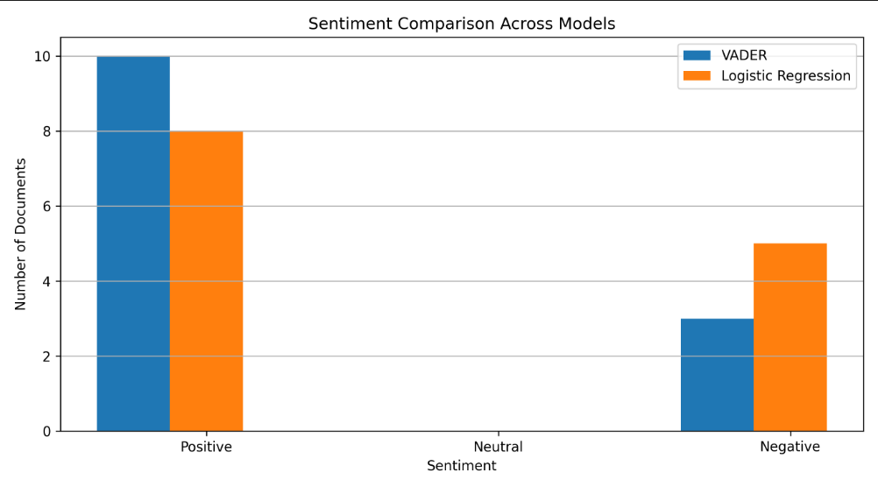
SENTIMENTAL ANALYSIS
Rules and heuristic(VADER):
Best for noisy text
Handles emojis 😄🔥😡
Handles CAPITAL words
Handles punctuation !!!
Designed for social / real-world text
Machine Learning:
Fast speed
Can’t handle Emojis
Medium accuracy
Logistic Regression is EXCELLENT as a classical ML baseline
Convert text → numbers (TF-IDF)
Train Logistic Regression on labeled data
Compound Score | Sentiment
≥ 0.05 | Positive
≤ -0.05 | Negative
Else | Neutral
For this we need to download the VADER dictionary which is a predefined emotion dictionary
compound = final emotional score(Quick Estimate)
Range: −1 to +1
VADER compound is reliable for SHORT texts.
It becomes misleading for longer texts/documents

Slide 10
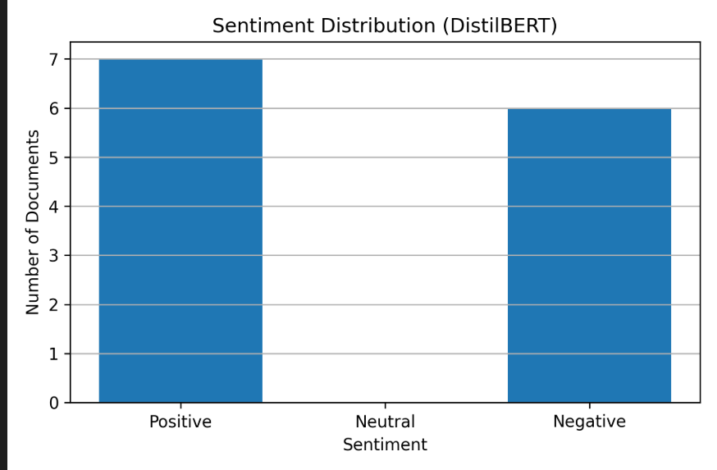
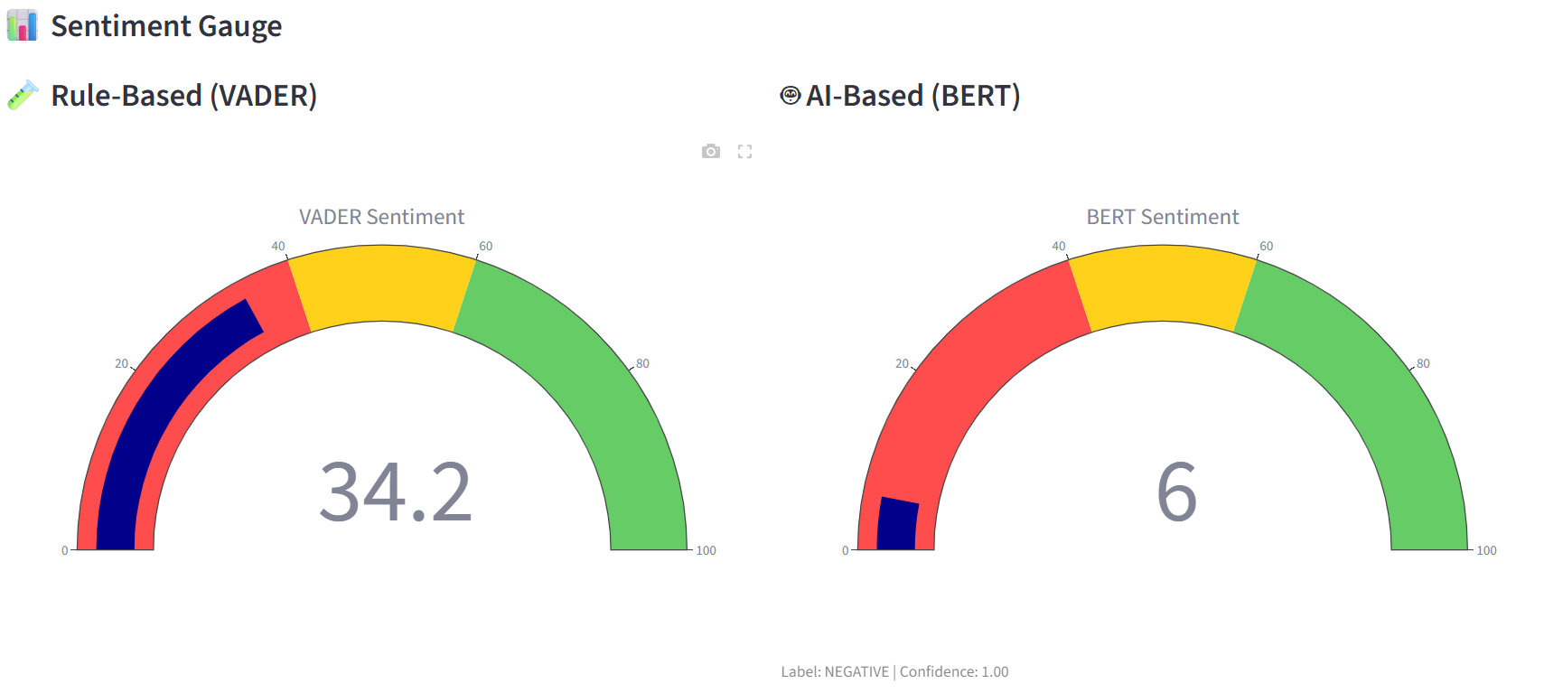
VADER AND BERT SHOWING THAT THE GIVEN DOCUMENT IS NEGATIVE
It describes how many documents are positive and negative by DistiBert
DEEP LEARNING:
we use a model called DISTILBERT which is fast,lightweight,accurate.
It was unable to understand the emojis But it still understands the sentiment of the text even if emojis are present.
distilbert-base-uncased-finetuned-sst-2-English this is the model we used here,it trained on plain English sentences
Emojis are tokenised as [UNK](unknown token).
The model relies on semantic and contextual understanding of the text.
It understands the meaning of the text.

Slide 11
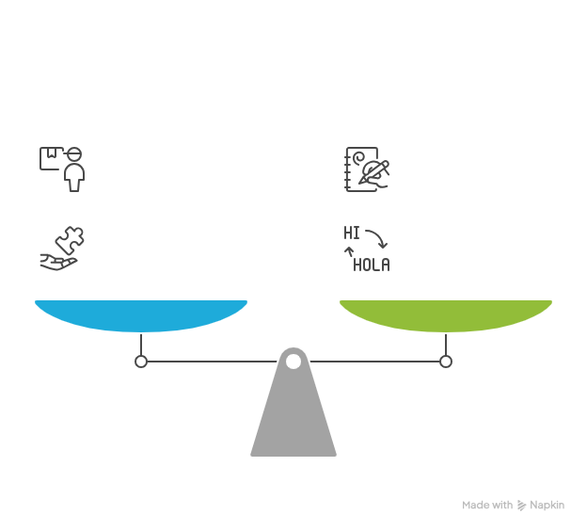
SUMMARISATION
What it does internally :
*TextRank is an ALGORITHM,
More precisely: a graph-based ranking algorithm
* Split document into sentences
* Find important words (frequency-based)
*Score each sentence
*Pick top N sentences
*BART is a deep neural network
*Nearly 400 million parameters
*Transformer-based (encoder–decoder)
*Designed for semantic understanding + generation
*I used DISTILBART for summarisation it gives maximum of 220 words it is slow on CPU but gives very accurate results.

Slide 12
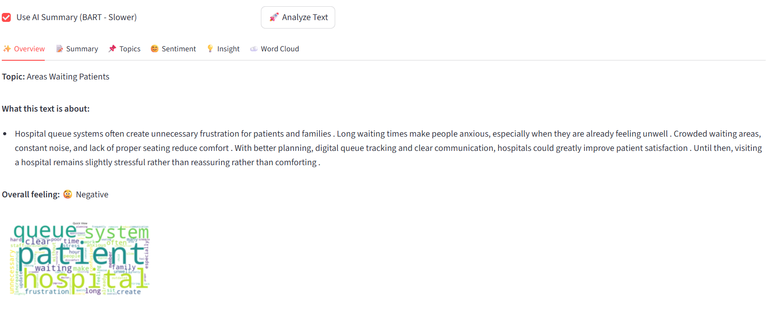
INSIGHTS AND VISUALIZATIONS
This project successfully demonstrates how Artificial Intelligence and Natural Language Processing can transform unstructured text into meaningful, human-understandable insights.
By combining semantic understanding (AI-based models) with statistical topic modeling (LDA), the system overcomes the limitations of traditional text analysis and delivers accurate, context-aware topic detection. The inclusion of both rule-based and neural network–based sentiment analysis ensures reliable emotional interpretation of content, while automatic summarization helps users quickly grasp the core meaning of large documents.
This project successfully demonstrates how Artificial Intelligence and Natural Language Processing can transform unstructured text into meaningful, human-understandable insights.

Slide 13
THANK YOU

